Slide 1

P.2 Discount shopping
Discount service shopping
Tickets, Books, Techs, Stationary
Subscribers
Delivery(if not ticket)
Online/offline

Slide 2
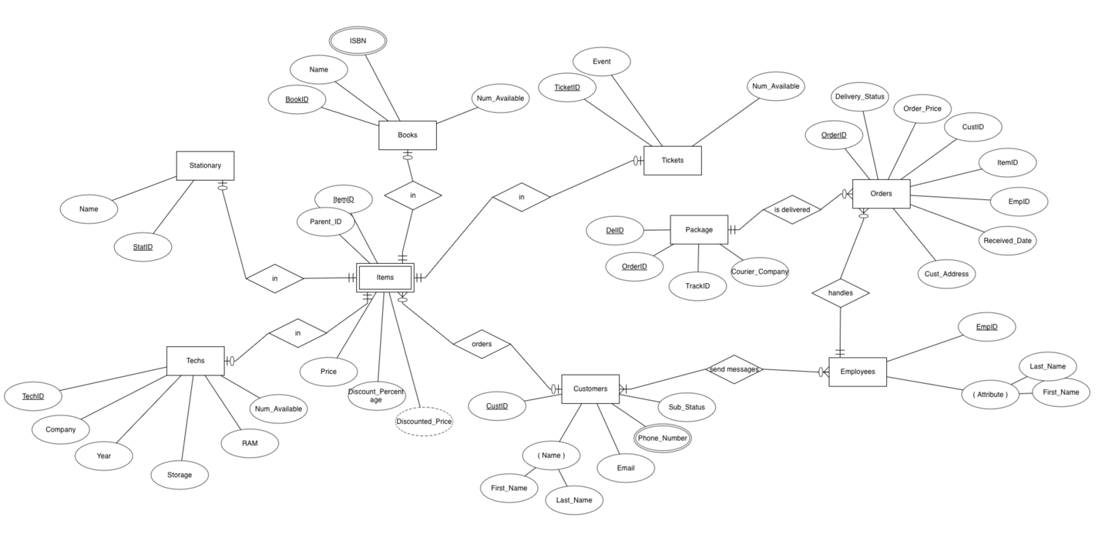
Chen Notation Diagram

Slide 3
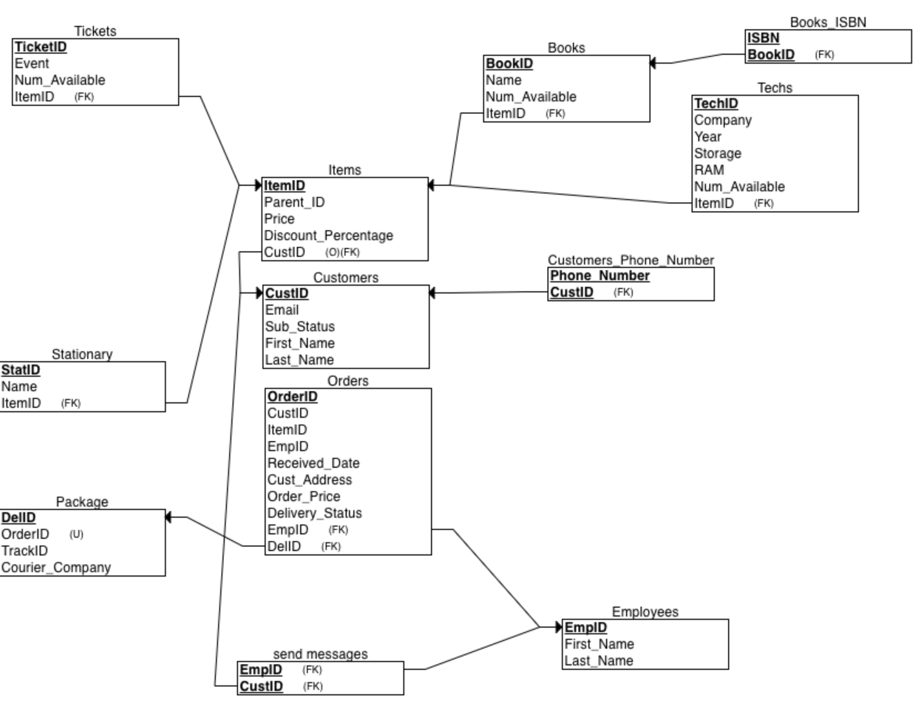
Crow’s Foot Diagram

Slide 4

SQL

Slide 5
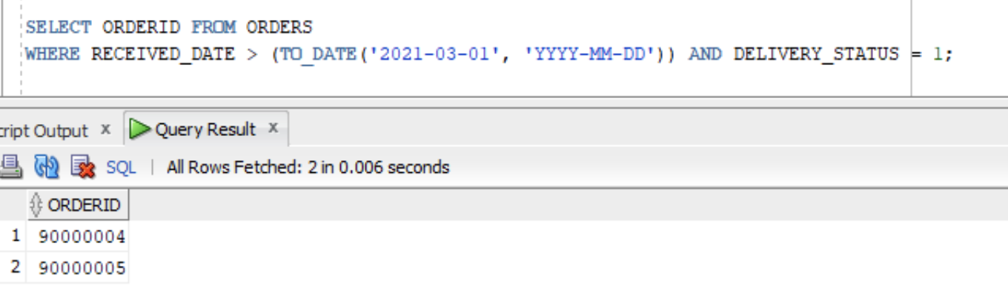
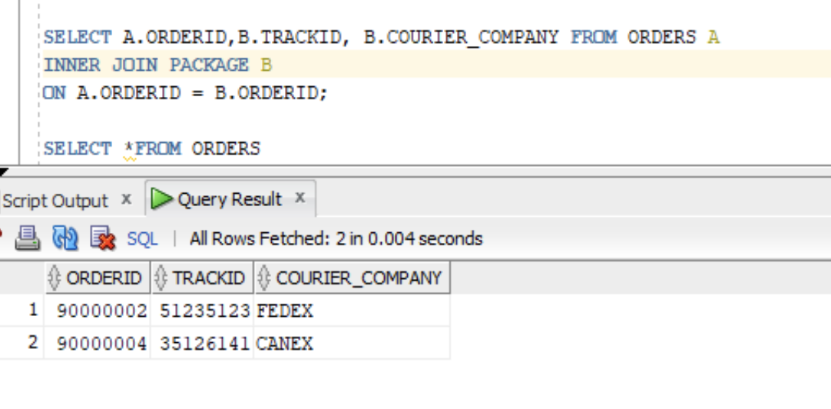
Some insertions
INSERT INTO ORDERS VALUES (90000001, 1001, 1000001,3, TO_DATE('2021-02-28','YYYY-MM-DD'), '25 K.AKHUNDOV', 1800*0.9, 1);
INSERT INTO STATIONARY VALUES(130001, 'SHARPENER', 10000003 );
INSERT INTO BOOKS_ISBN VALUES(9789083123146, 140001) ;
SELECT *FROM ORDERS WHERE DELIVERY_STATUS = 0; -> orders which should not be delivered
SELECT ORDERID FROM ORDERS WHERE RECEIVED_DATE > (TO_DATE('2021-03-01', 'YYYY-MM-DD')) AND DELIVERY_STATUS = 1 ; -> find orderID of those whose orders will be delivered and their order happens after 2021 March.
SELECT A.ORDERID,B.TRACKID, B.COURIER_COMPANY FROM ORDERS A INNER JOIN PACKAGE B ON A.ORDERID = B.ORDERID; -> show courier name, trackid of the orders which will be two values

Slide 6
How can we improve it?
Add courier name, customer_name to orders and packages
Add delivery date, is_delivered attribute to package
Add expected delivery too

